Slide 1
Hands-on session: River Library
Alessio Bernardo
Post-doc @ Politecnico di Milano
CTO & Co-founder @ Motus ml

Slide 2

Me
Alessio Bernardo, Ph.D.
Post-doc @ Politecnico di Milano
CTO & Co-founder @ Motus ml
5 years of experience in research in the Streaming Machine Learning field with evolving data streams, concept drifts, and class imbalance;
Focus on applying Streaming Machine Learning techniques in constrained environments at the network's edge.
https://alessiobernardo.github.io/
https://motusml.com/

Slide 3
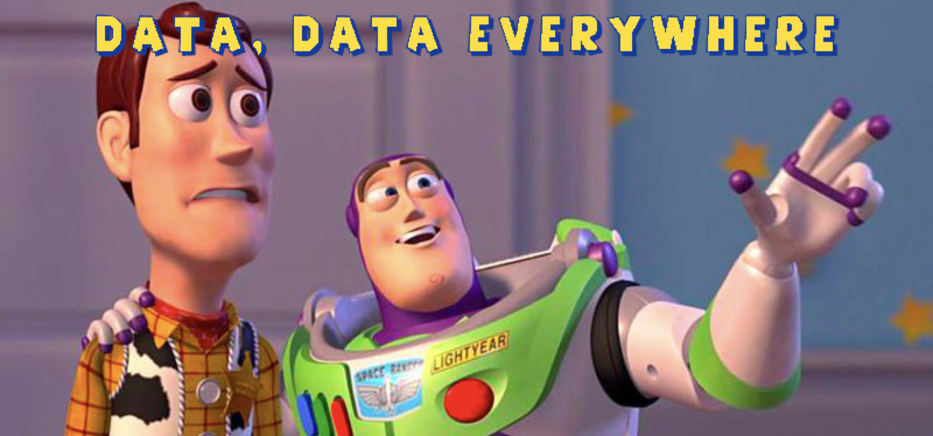
It is a Streaming World …

Slide 4
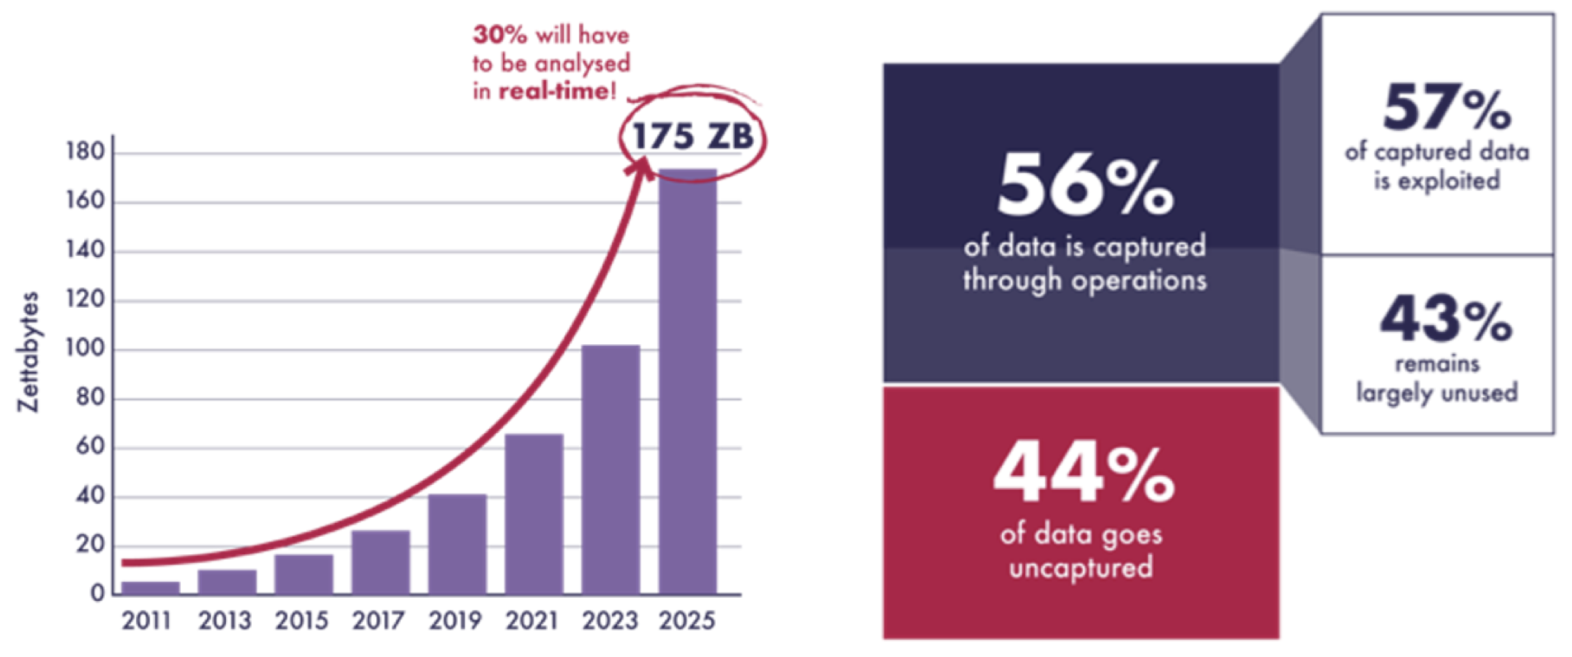
… but 68% of data are not used
Src: Seagate
Notes:
In particular, by 2025, it is estimated that at least 175 ZB of data will be produced each year, but, since we are one order of magnitude far away from the ability to store all of them in memory, about 30% of them will have to be analyzed in real-time.
Moreover, the 44% of the data generated are not captured due to inadequate infrastructures. In addition, about 43% of the captured data are unused due to inadequate techniques. In total, around 68% of data produced are not used

Slide 5
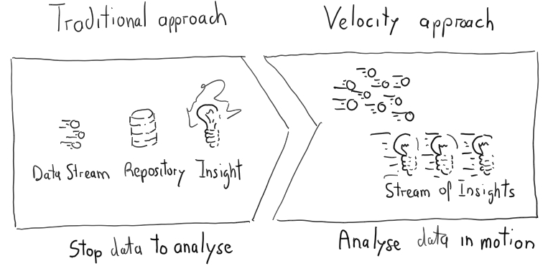
Traditional approach vs …
Notes:
Usually, when a new sample is available, is saved and stored in a batch. Then, the entire batch is analyzed as time series.

Slide 6
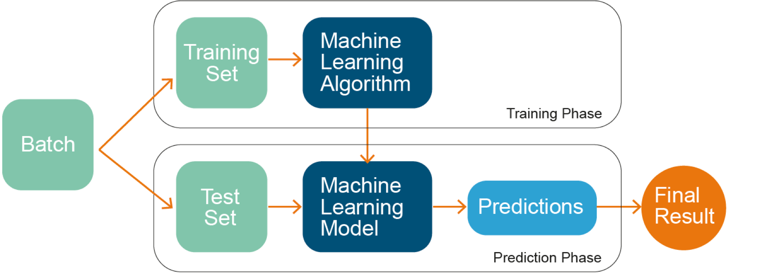
ML models
Notes:
In this category falls the standard machine learning techniques. They use a static batch of data that doesn’t evolve in time, they split it into training and testing sets, they train a model with the training set and then they test it using the testing set. When a new data is available, the only thing they can do is to add it in the end of the batch, re-split it and re-train a model from scratch. So, with data streams this approaches are unfeasible

Slide 7
Traditional vs. Velocity-oriented approach
Notes:
Al posto di salvare lo stream nella repo e renderlo statico e estrarre da li insights, si può…..

Slide 8
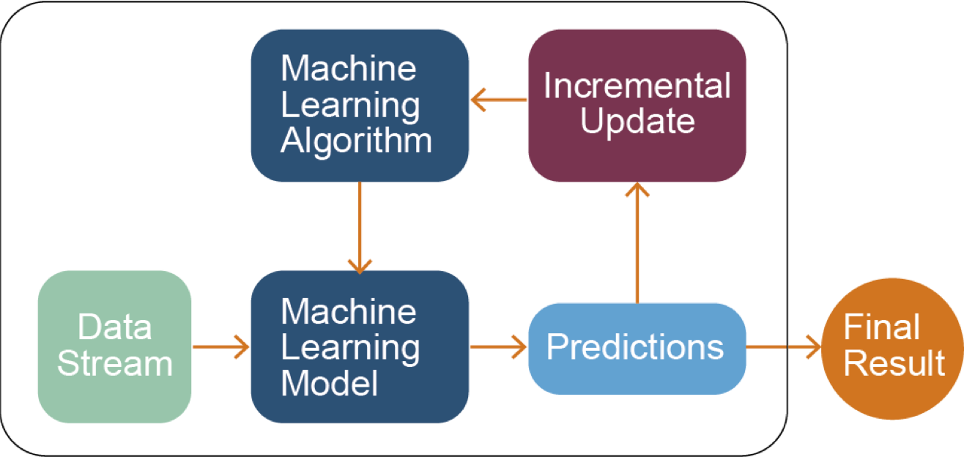
SML models
A. Bifet, G. de Francisci Morales, J. Read, G. Holmes, and B. Pfahringer Efficient online evaluation of big data stream classifiers. ACM SIGKDD 2015
Notes:
In particular, SML algorithms are able to continuously incorporate new data without retraining their models from scratch. Moreover, they firstly use the new sample in input to test the model and then to update it. This particular approach is called prequential evaluation and it solves the problem that the testing set is not available.
Citare prequential evaluation

Slide 9

SML models
Incremental learning
Unbounded real-time data
Resource efficient
Dynamic models
Notes:
For these reasons, the SML was introduced. it is able to maintain models online that means:
We don’t have the entire data available, so an online model needs to incorporate one sample at a time. Moreover the stream is unbounded, so it must be able to update the model every time. It’s impossible to retrain the model from the beginning every new sample. Since the stream is unbounded, the model needs to manage the data in a proper way. It’s unfeasible to save all the samples arrived. In fact after the testing and the training phase the sample is discarded. Since the steam evolves in time, it can present some form of non stationary. An online model must be dynamic and adapt to it.

Slide 10
SML models
Benefits
Challenges
One sample at a time
Incremental models
Time & Memory management
Data stationarity (concept drift)
Class imbalance
Hyper-parameter tuning

Slide 11
Concept Drift

Slide 12
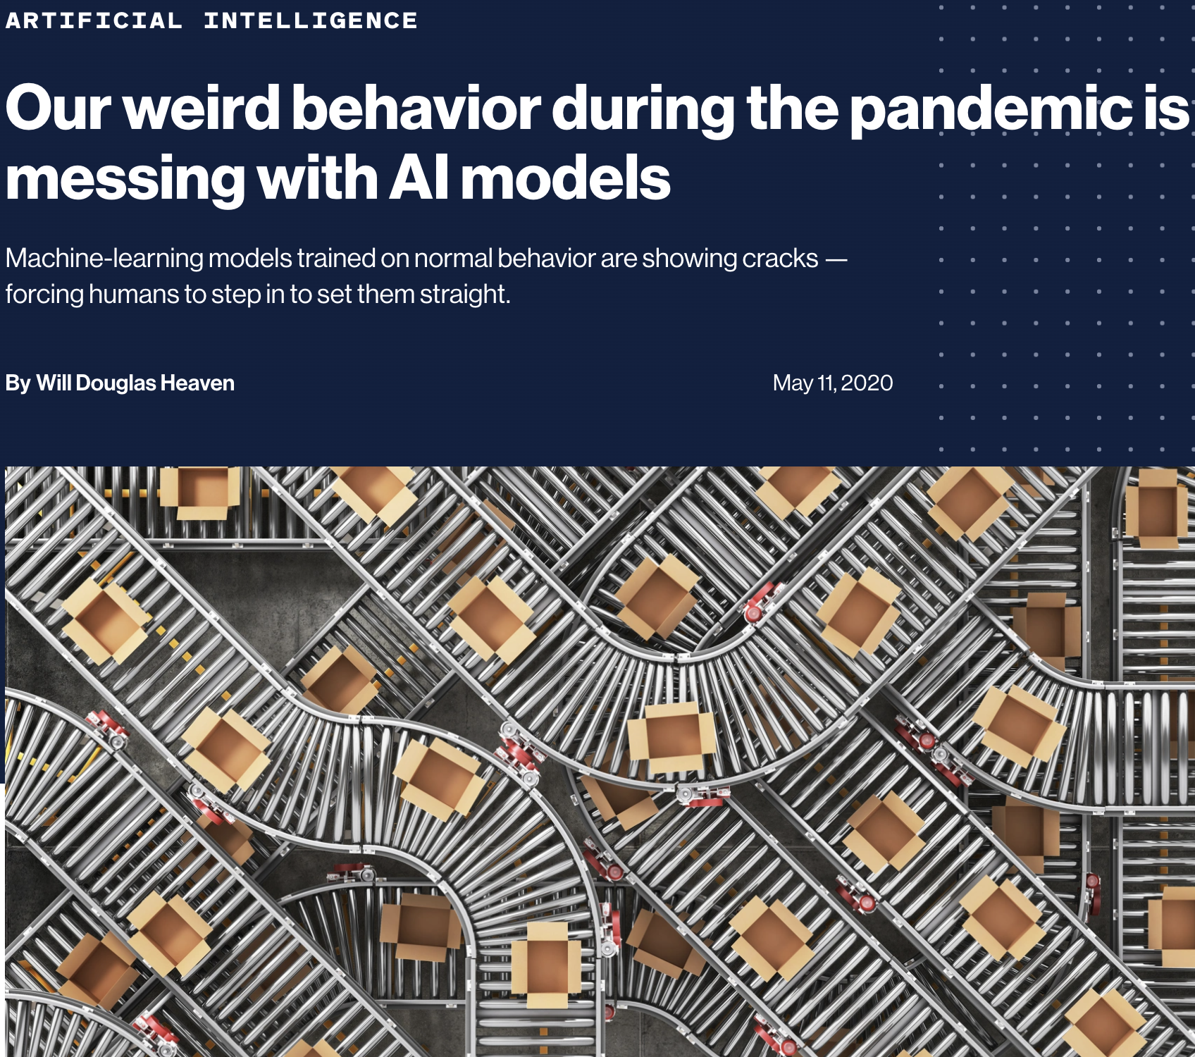
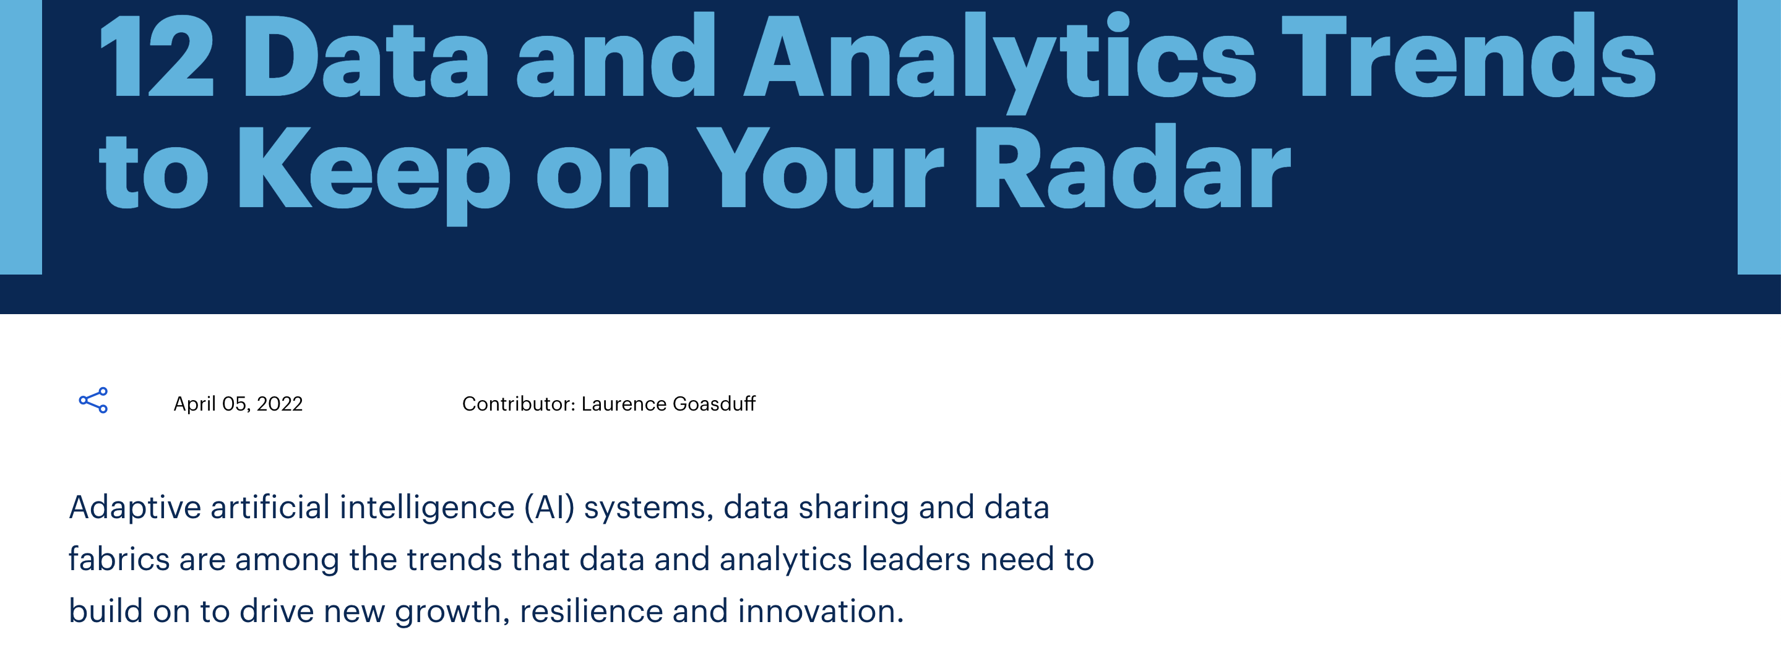
Heaven, W. D. (2020). Our weird behavior during the pandemic is messing with AI models. MIT Technology Review)
https://www.gartner.com/en/articles/12-data-and-analytics-trends-to-keep-on-your-radar
Notes:
For these reasons, the SML was introduced. it is able to maintain models online that means:
We don’t have the entire data available, so an online model needs to incorporate one sample at a time. Moreover the stream is unbounded, so it must be able to update the model every time. It’s impossible to retrain the model from the beginning every new sample. Since the stream is unbounded, the model needs to manage the data in a proper way. It’s unfeasible to save all the samples arrived. In fact after the testing and the training phase the sample is discarded. Since the steam evolves in time, it can present some form of non stationary. An online model must be dynamic and adapt to it.

Slide 13
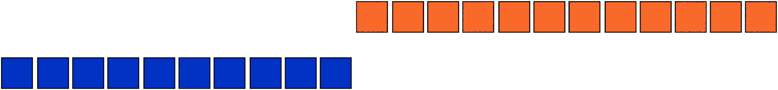
What is a concept drift?
Distribution
Time
A. Tsymbal The problem of concept drift: definitions and related work Trinity College Dublin, 2004
Notes:
The non stationary is called concept drift phenomena. Streams evolve in time so the statistics of such data are subject to gradual or sudden changes, without any warning. The risk is that the model trained up to that point doesn’t fit anymore the new data. It is not enough to build a model able incorporate one sample at a time, but we need also to adapt the model built until now to manage concept drift. For this reason a SML model must be dynamic

Slide 14

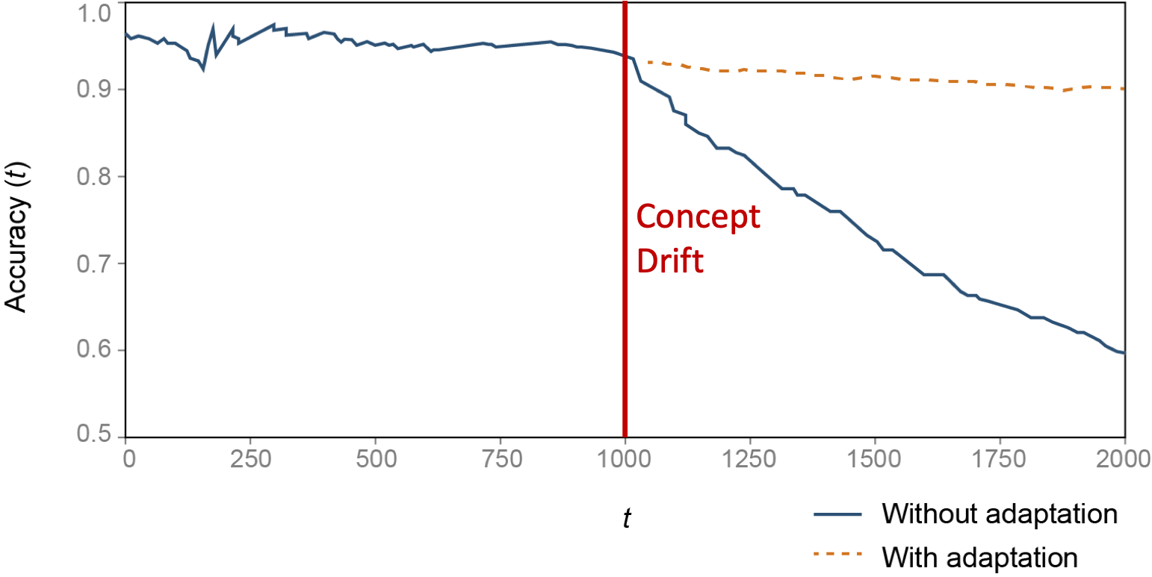
What is a concept drift?
Class 1
Class 2
Concept Drift
A. Tsymbal The problem of concept drift: definitions and related work Trinity College Dublin, 2004

Slide 15
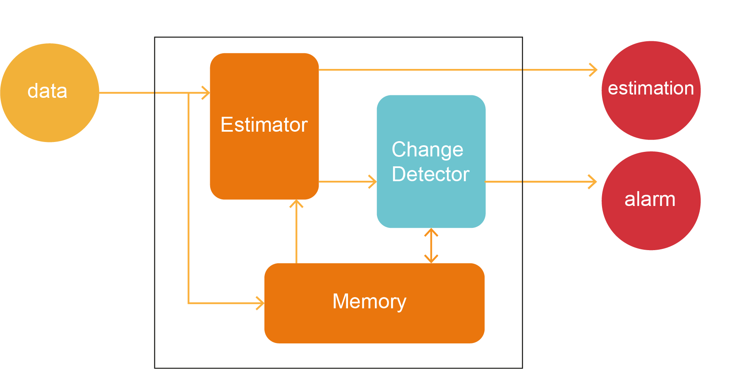
What is a concept drift?
Bifet, A. and Gavaldá, R. Adaptive Learning from evolving data streams. In International Symposium on Intelligent Data Analysis (pp.249-260).Springer 2009, August.

Slide 16
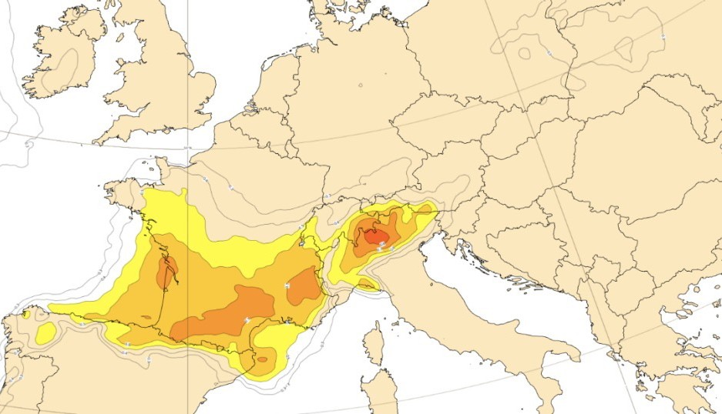
What is a concept drift?
Example – Weather forecast
The chaotic nature of the atmosphere leads to continuous and sudden weather changes (concept drifts)
Weather forecast models must detect these changes and adapt to them, without be retrained from scratch

Slide 17


Hands-on River

Slide 18
Credits
Albert Bifet DATA STREAM MINING 2020-2021 course at Telecom Paris
Alessio Bernardo & Emanuele Della Valle

Slide 19
Hands-on session: River Library
Alessio Bernardo
Post-doc @ Politecnico di Milano
CTO & Co-founder @ Motus ml

